Slide 1

Exploratory Data Analysis on AMEO Dataset

Slide 2
About me
I completed my B.Tech in 2015 and have accumulated over 4 years of experience in web designing.
Now, I aim to transition my career and upgrade my skill in new technology, which is why I've chosen Data Science.
Linkedin: https://www.linkedin.com/in/rizwana-yasmeen/
GitHub: https://github.com/rizwanayasmeen

Slide 3
Objective
To analyze the employment outcomes of engineering graduates. The study aims to explore relationships between various factors (standardized scores, demographic features) and employment-related variables (Salary, Job Titles, and Job Locations). Through univariate and bivariate analyses, the goal is to derive insights into the distribution, patterns, and potential relationships within the dataset.

Slide 4
Dataset Description
The dataset, released by Aspiring Minds from the Aspiring Mind Employment Outcome 2015 (AMEO), is focused on engineering students. It encompasses the employment outcomes of these graduates, including dependent variables such as Salary, Job Titles, and Job Locations. The dataset also includes standardized scores from three key areas: cognitive skills, technical skills, and personality skills. Demographic features are incorporated, resulting in around 40 independent variables and 4000 data points. The independent variables comprise both continuous and categorical features, and each candidate is uniquely identified by an ID.

Slide 5
Data Cleaning and Manipulation
There is an unnamed column, as it has only single value, we cannot use this for data analysis. So we need to drop that column. Dropping unnecessary columns to keep our dataset clean (Such as 'Unnamed: 0','ID','CollegeID','CollegeCityID’).
The 'DOJ' and 'DOL' columns contain timestamps, which we'll convert into date format using the datetime module. In the 'DOL' column, instances of 'present' will be converted into the current date for our analysis.
Dropping the row which has DOL is greater than DOJ.
Extracting the mode of the '10board’, ‘12board' columns under various conditions (e.g., for specific designations, genders, percentages, cities, etc.) and replacing 0 with mode value.
We need to handle the 'get' values in the 'Designation' column which is not a desired value by replacing them with the mode of the column.
Replacing Nan value in Jobcity column with mode and cleaning the column which have similar meaning.
Checking the distribution of -1 value in the columns and dropping drop those columns where the percentage of -1 values is greater than 80%.
Specializations has many values. We need to impute it with simplified set of categories.

Slide 6
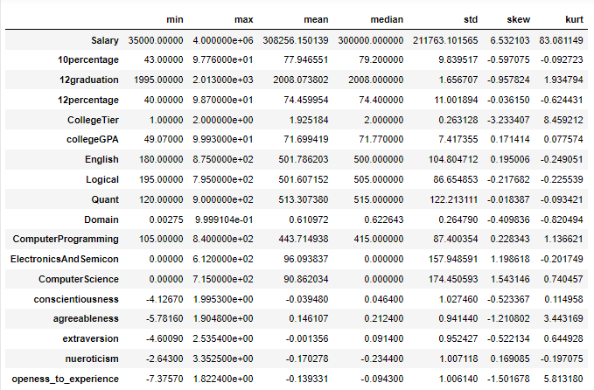
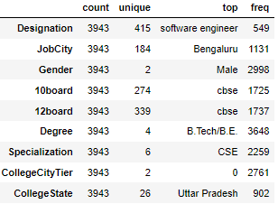
Univariate Analysis

Slide 7
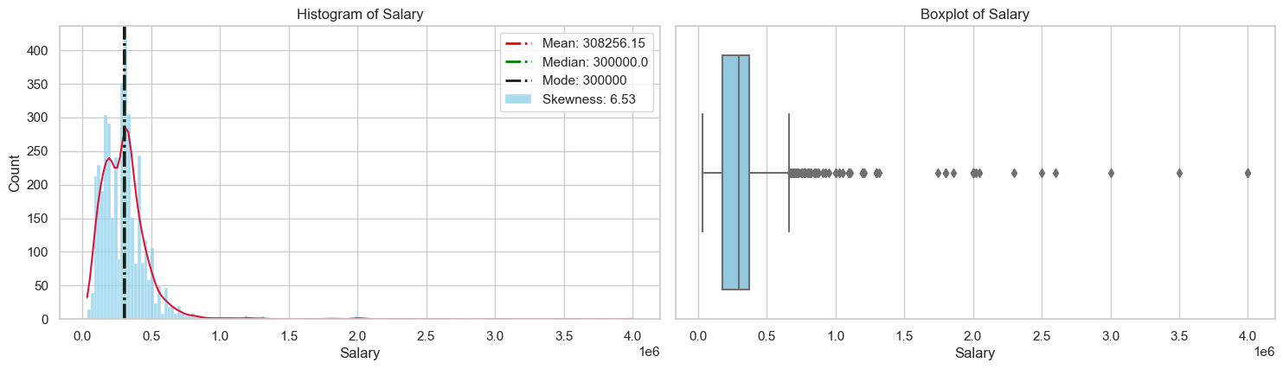
Univariate Analysis
The plot exhibits a right-skewed distribution with a long tail on the right side, resembling a log-normal distribution. The box plot illustrates a significant concentration of data points at higher salary levels.

Slide 8
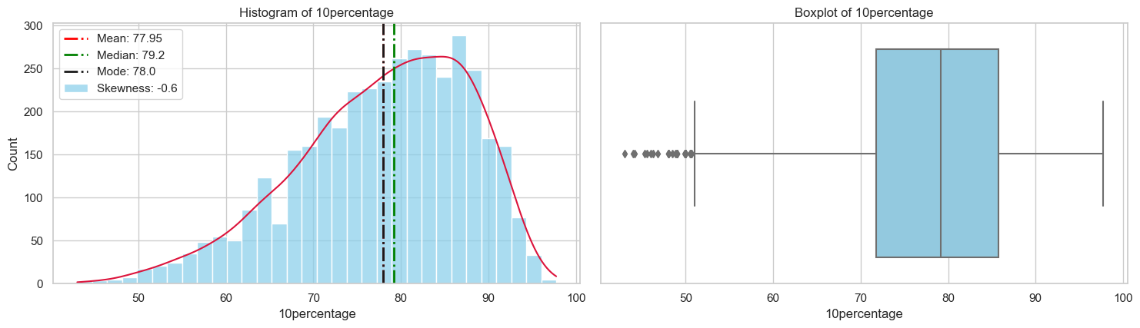
Univariate Analysis
The histogram shows a moderately negatively skewed distribution with a skewness value of -0.6, indicating a slight leftward asymmetry. The box plot further highlights the existence of a few extreme outliers.

Slide 9
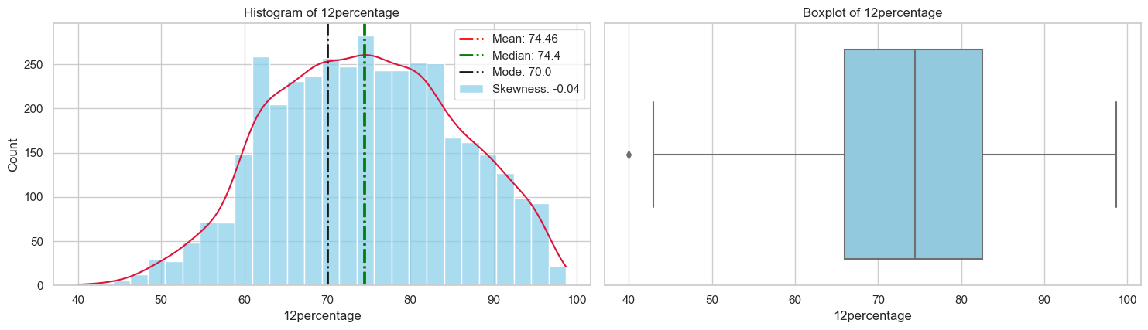
Univariate Analysis
The plot displays a close to normal distribution as a symmetric distribution as the skewness is so small. The box plot reveals a single data point with an exceptionally low score.

Slide 10
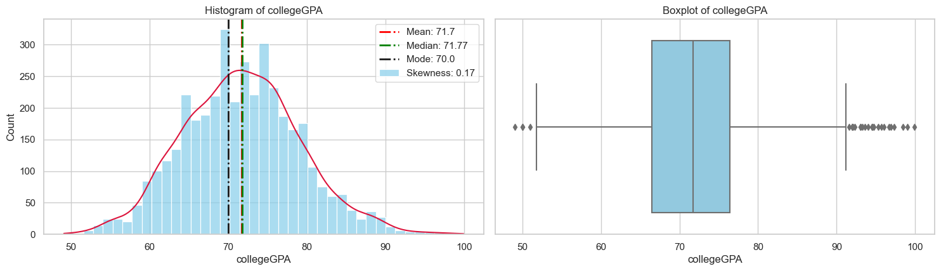
Univariate Analysis
The plot exhibits normal distribution as the skewness is 0.17, The box plot reveals the presence of both low and high extreme values within the dataset.

Slide 11
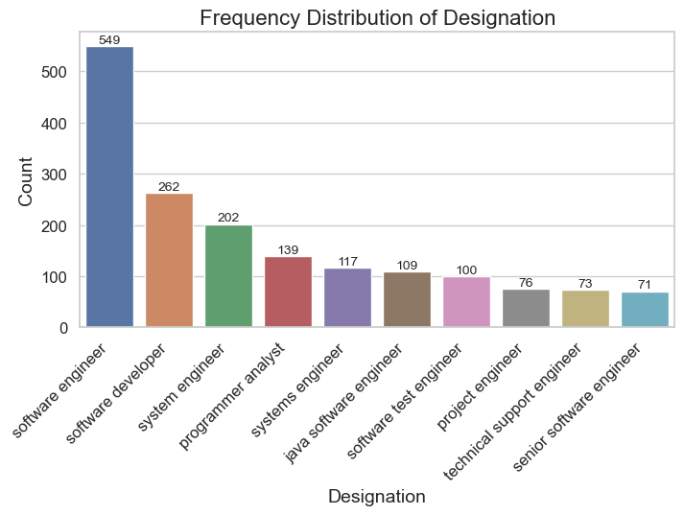
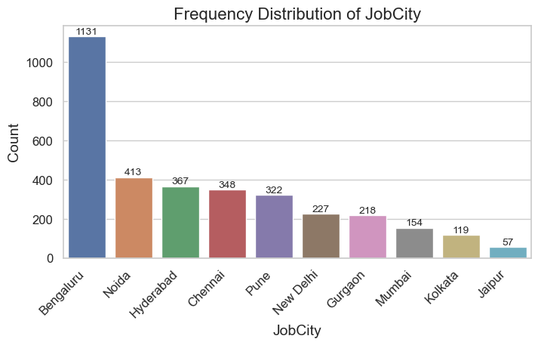
Univariate Analysis
The predominant job title is Software Engineer followed by software developer, system engineer, and other disciplines.
Most of the employees are working in the city of Bengaluru.

Slide 12
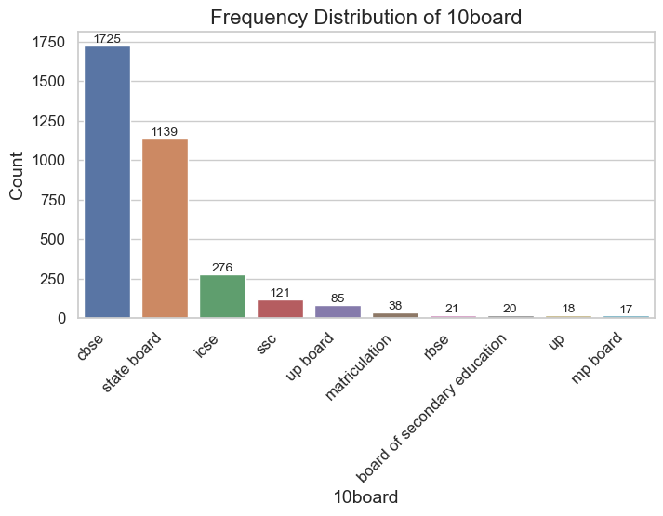
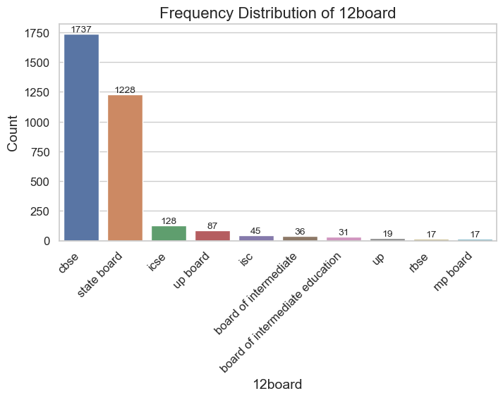
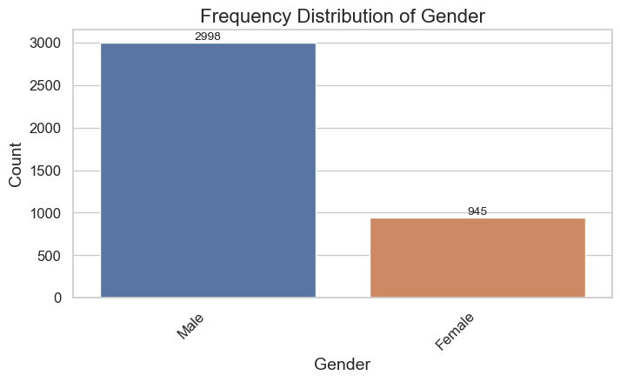
Univariate Analysis
The ratio of Male/Female is 2.9 indicates there are 3 times more men than women employed.
Majority of the students in 10th and 12th standard are from the CBSE followed State board.

Slide 13
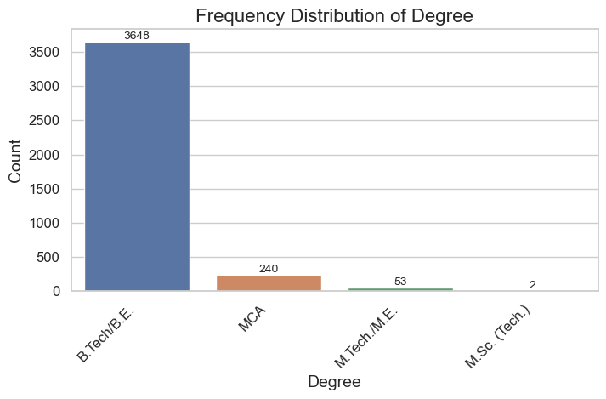
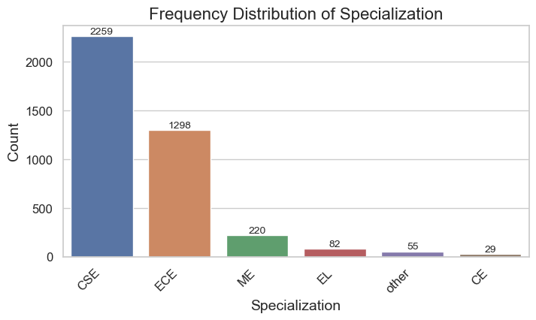
Univariate Analysis
B.Tech/B.E is the dominant degree, surpassing others.
Most of the Specialization is focusing on Computer Science, followed by Electronics/Electrical, Mechanical, and other disciplines.

Slide 14
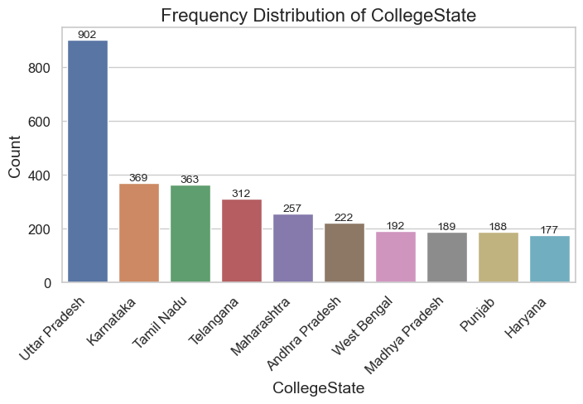
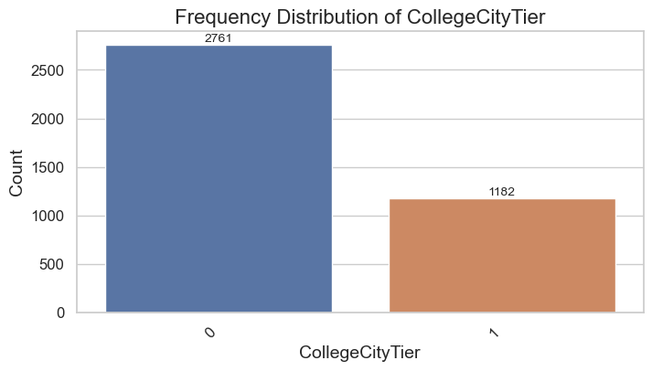
Univariate Analysis
Most colleges in the dataset are categorized as Tier 0, reflecting their prevalence in the real world, while only a few are designated as Tier 1.
Most of the data belonging to students who attended colleges in Uttar Pradesh.

Slide 15
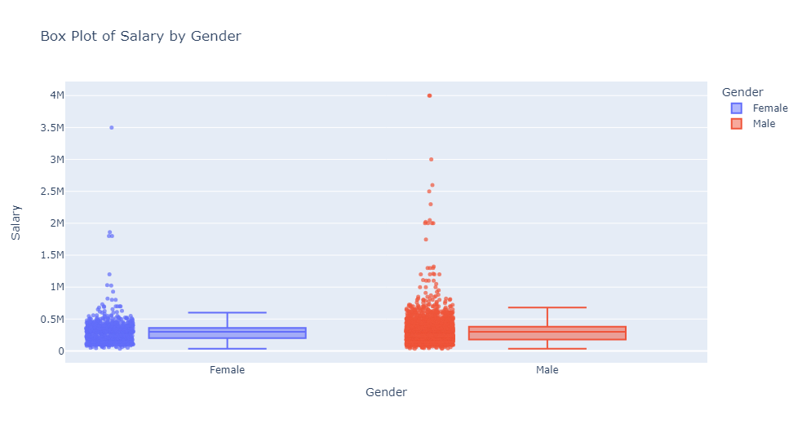
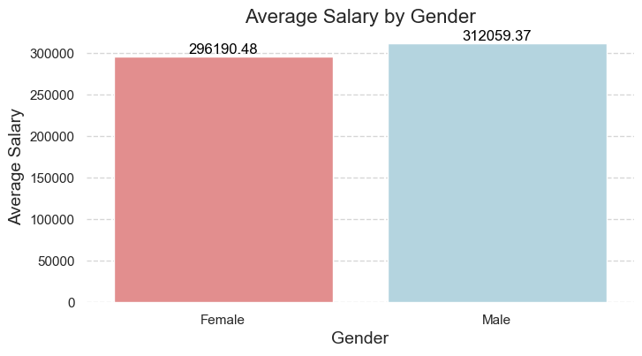
Bivariate Analysis
The average salary for males is 31K, whereas for females, it is 29K.
The upper fence for male salaries is 680K, whereas for females, it is 600K. We can also observe male have more outliers indicating they are more people getting higher pays in male than female category.
The maximum salary for males is 4M, while for females, it is 3.5M.

Slide 16
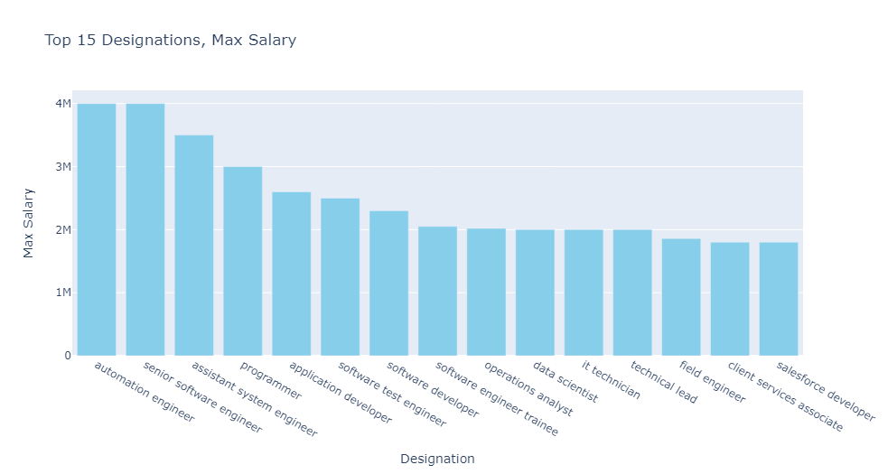
Bivariate Analysis
The top designations based on the highest salary are Automation Engineer, followed by Senior Software Engineer with a maximum value of 4 million, and Assistant System Engineer, along with other professions.

Slide 17
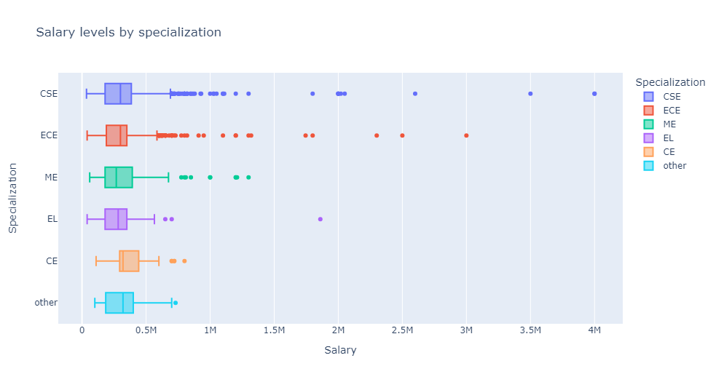
Bivariate Analysis
The median salary is nearly similar across all specializations. However, individuals with specializations in CSE and ECE tend to have a higher percentage of higher-paying positions compared to other specializations.

Slide 18
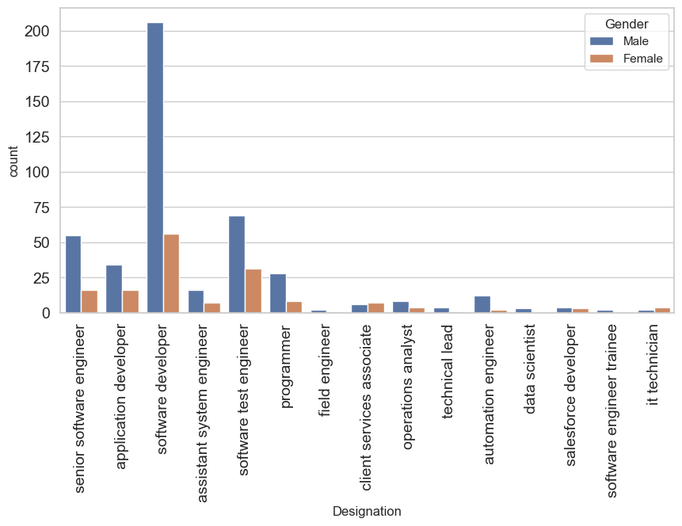
Bivariate Analysis
Most individuals in the top designations, based on the highest salary, hold the title of Software Developer. This field is notably male-dominated, with a substantial difference in gender frequency across various roles.

Slide 19
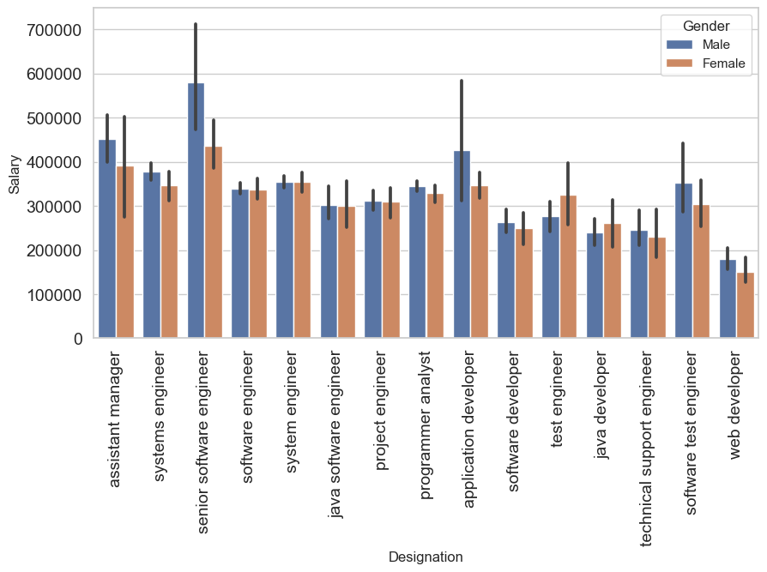
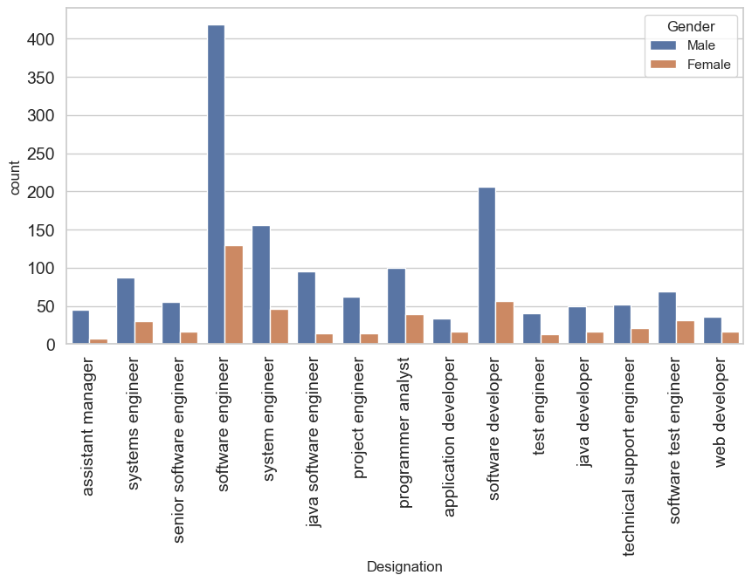
Bivariate Analysis
The mean salary for the most frequently held roles appears to be nearly independent of gender. While there are significant differences in some roles, it cannot be conclusively stated that women are being paid less in those positions. These discrepancies may be attributed to factors such as specialization, and other variables.

Slide 20
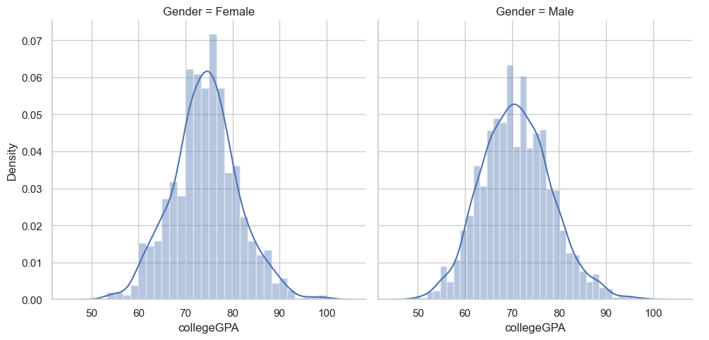
Bivariate Analysis
Both the distributions of college GPA for males and females appear to be normal, centered around the 75% mark. The similarity between the distributions for both genders is evident. The narrow interquartile range (IQR) indicates that most students have similar CGPA in the 70-75% range. However, there are outliers with CGPA below 20 and above 90.

Slide 21
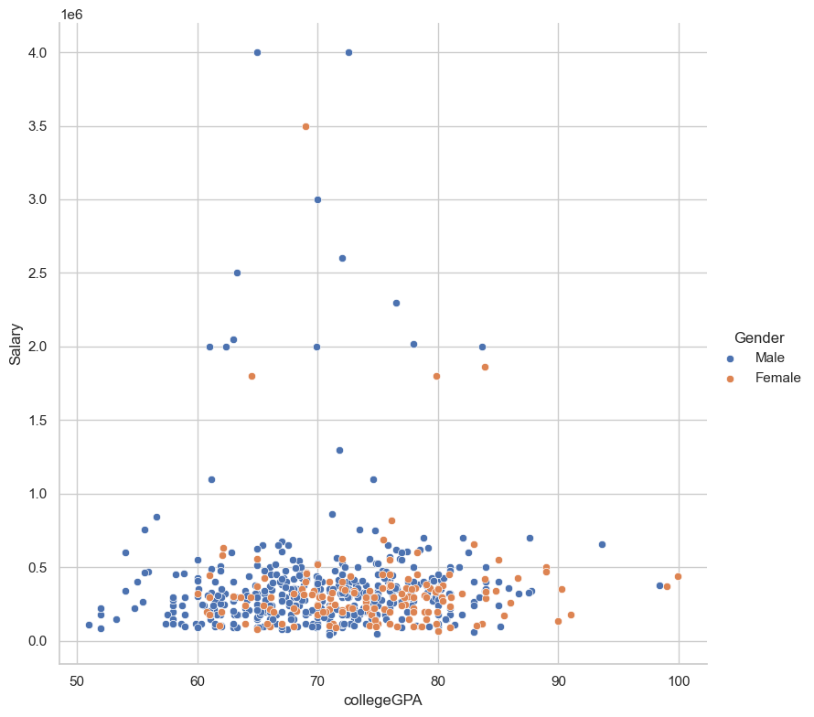
Bivariate Analysis
Most of both men and women have CGPA in the range of 70-75, which is considered good. There is no observable correlation suggesting that having a high or low GPA significantly impacts salary, and this is consistent for both genders. Therefore, we can infer that GPA is not a decisive factor contributing to the gender pay gap, as the distributions overlap extensively

Slide 22
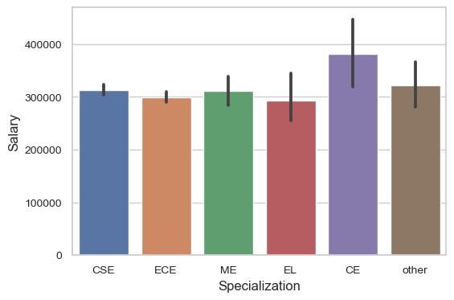
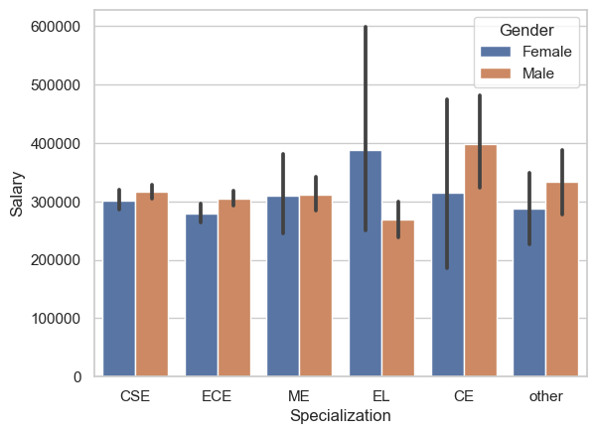
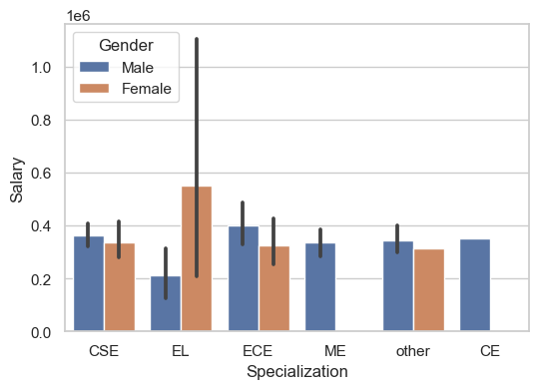
Bivariate Analysis
Individuals from the CE branch earn the highest average pay, while all other branches receive nearly similar average pay.
Men from CSE,ECE,CE Earn slightly greater than women from this specialization. Women from the EL specialization Earns way more than men from same specialization.
For those with higher pay, individuals from the CE specialization consist of only men. Specialization does not seem to be the primary reason for the gender pay gap, especially in fields like CS, where men and women earn similar salaries.

Slide 23
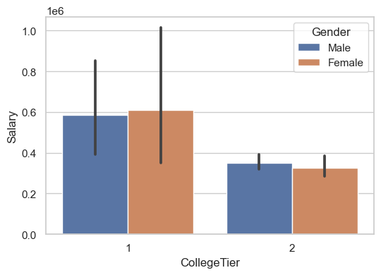
Bivariate Analysis
The bar graph indicates that students from tier-1 colleges generally receive higher salaries. It's evident that there are more men from tier-1 colleges than women, and overall, a majority of students come from tier-2 colleges. This could contribute to the gender pay gap, as a significant number of women are from tier-2 colleges.

Slide 24
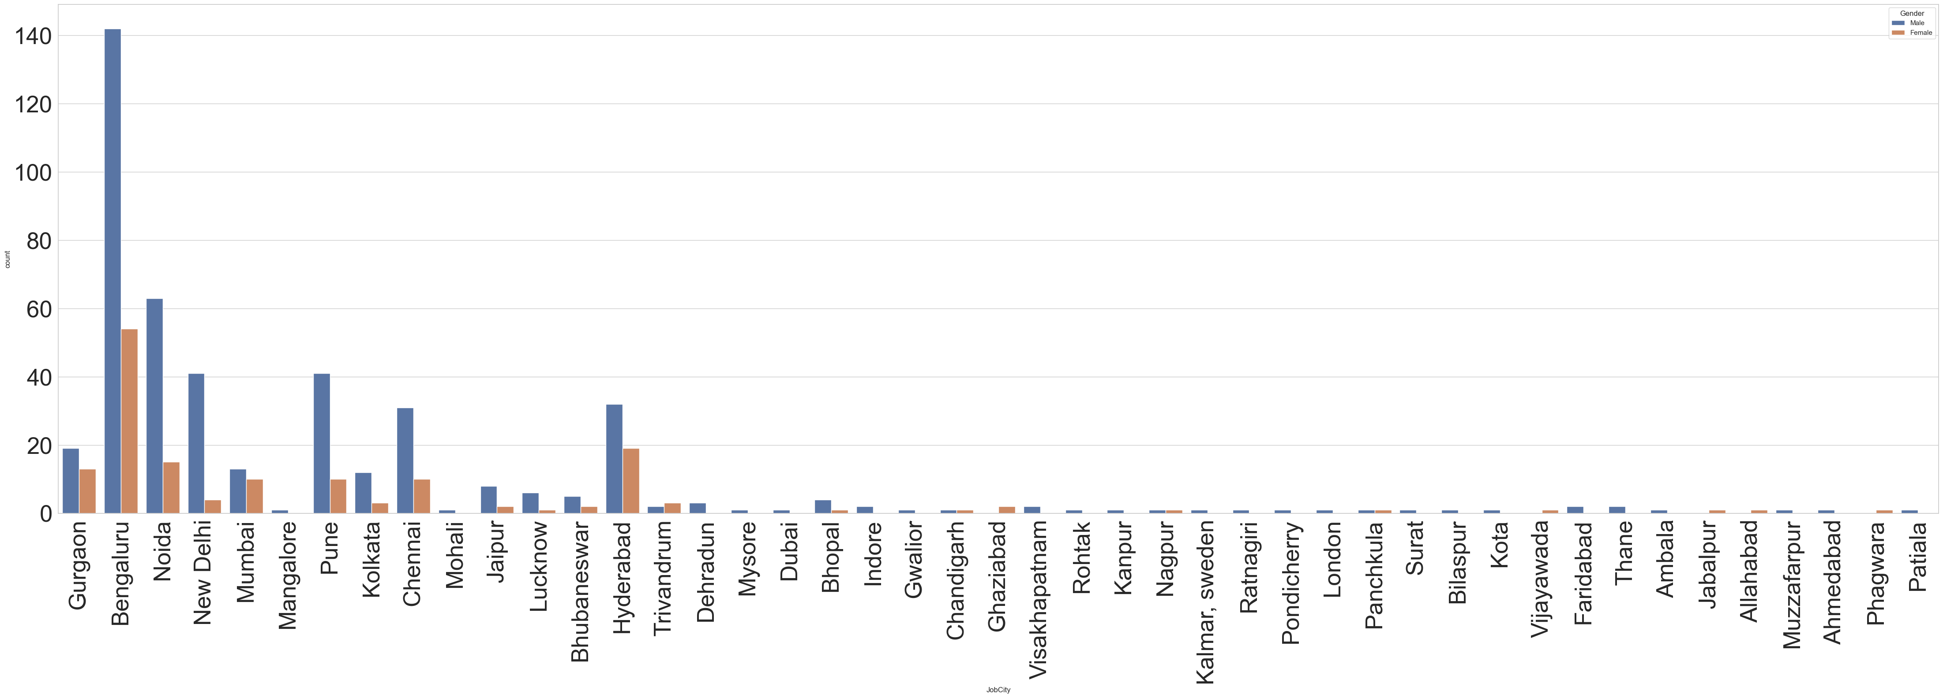
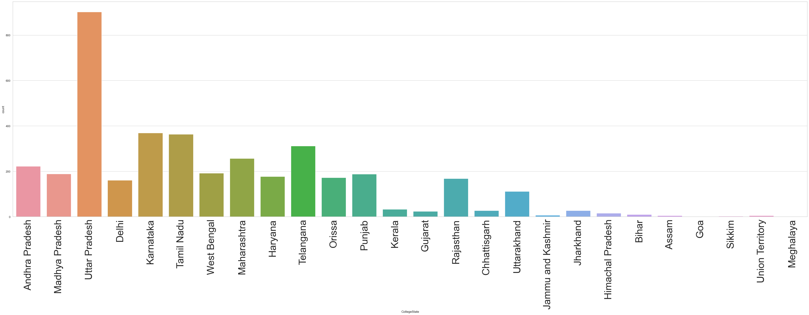
Bivariate Analysis
The primary locations where most AMCAT aspirants work include Bengaluru, Noida, Delhi, Hyderabad, Pune, Chennai and followed by other cities.
The majority of AMCAT aspirants specialize in CSE and ECE.

Slide 25
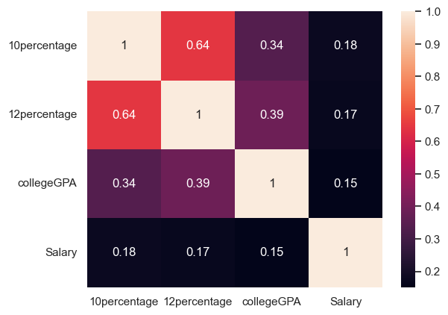
Bivariate Analysis
Salary is not dependent on percentages of 10th,12th and college GPA.

Slide 26
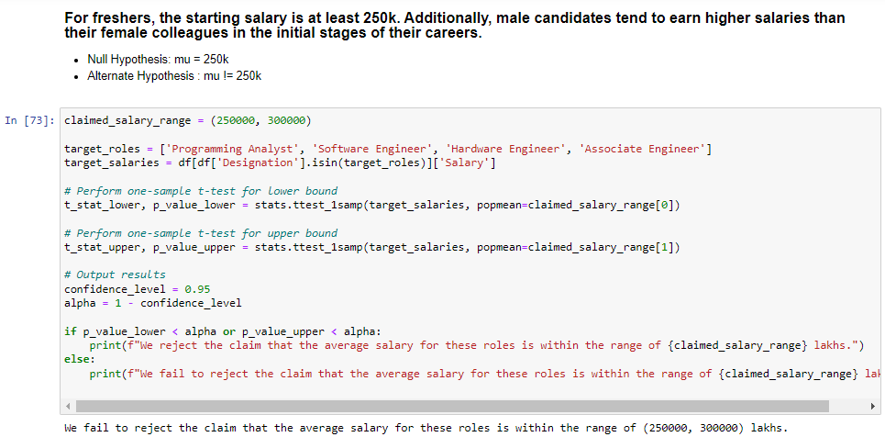
Research Questions

Slide 27
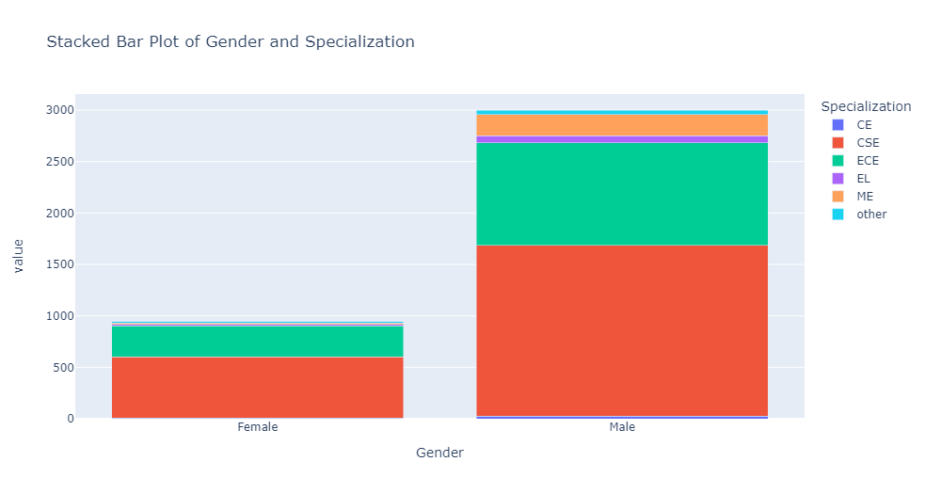
Bivariate Analysis
Is there a relationship between gender and specialization? (i.e. Does the preference of Specialization depend on the Gender?)
Null Hypothesis: There is a significant relationship between gender and specialization.
Alternate Hypothesis : There is no significant relationship between gender and specialization.

Slide 28
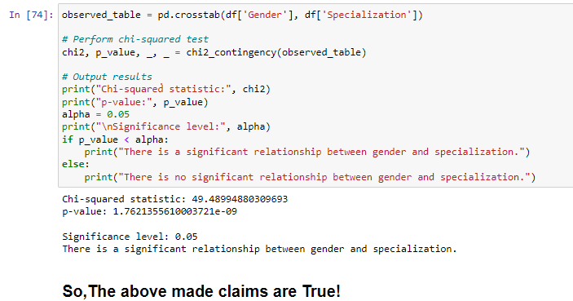
Research Questions

Slide 29
Conclusions
The majority of AMCAT aspirants are male professionals working in the CSE domain. They typically hold a degree in BTech, specializing in Computer Science or Information Technology, and mostly graduate from tier-2 colleges in Uttar Pradesh.
The average salary for these aspirants is around 300k.
High-paying jobs pursued by AMCAT aspirants are predominantly in the ‘CSE' domain.
Among the AMCAT aspirants, the most sought-after professions are Software Engineer and Software Developer.

Slide 30

THANK YOU

